Slide 1


Research & Development
Project
Presenters/Authors
Shailesh Krishna | Pranav Thakkar | Sairaj Rege | Divya Raghunathan
Facilitated by Sanjit Sengupta, Ph.D.
MSBA team – Spring 2020

Slide 2












3.Research
4.Search Engine & Social media Analytics
1.Introduction
2.Scope of work
AGENDA
5. Competitor Analytics
6. Fidelity website audit
7. Grok Investments website features
8. Wish list
9. Grok Investment website analytics
10.Results
12. Conclusion
11.Recommendation

Slide 3
BUS 899 - Independent Study
Fidelity Investments
Introduction:
Fidelity Investments holds a high place in the investments and finance market. But when it comes to the millennial demographic, our initial analysis shows that the millennials, especially women, are looking for answers to their investment-related queries more from Fidelity’s competitors. With this in mind, our aim is to recommend design and feature improvements for the Fidelity Investments website that would enable it to perform better on search engines and make it more attractive and relevant in the eye of the millennial.
Scope of work:
Suggestions for redesign and improvement of the Fidelity Investments website to help it cater better to Millennials, based on:
Analysis of competitor websites
Social media trends
Google search trends
Landing page/Website designed to test engagement on various features

Slide 4

Research
Phase 1:
Secondary research:
Top competitors, their products and services, website traffic
Primary research:
Social media analytics from Twitter, YouTube and Reddit.
Google search - Top related queries and entities
Phase II:
Primary research:
Quantitative data and testing results of the A/B/n tests of the landing pages

Slide 5
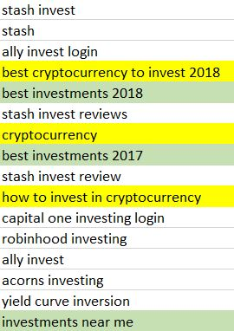
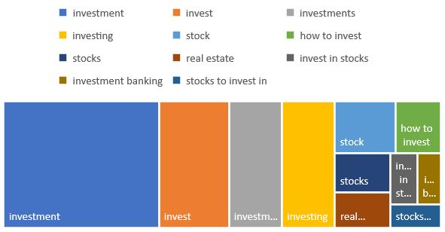
Search Engine Analytics - Google
Period of data - 5/17/2015 unto 4/25/2020
Top rising trends related to ‘investment’:
Top search queries related to the topic ‘investment’:

Slide 6
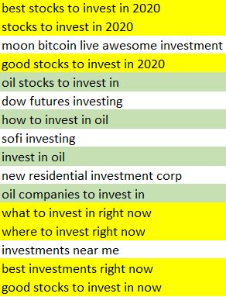
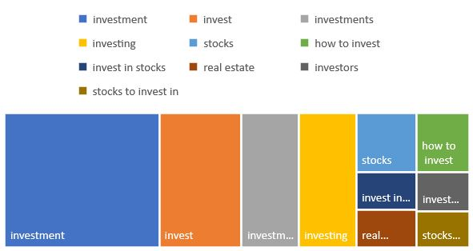
Search Engine Analytics - Google
Period of data - (past year)
Top rising trends related to ‘investment’:
Top search queries related to the topic ‘investment’:

Slide 7
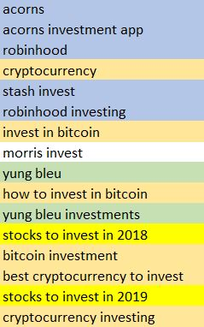
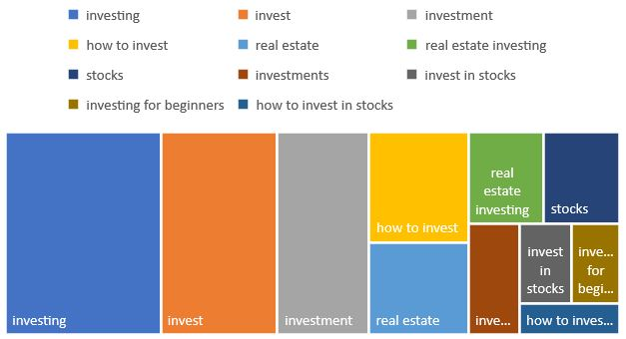
Social Media Analytics - YouTube
Period of data - 5/17/2015 unto 4/25/2020
Top rising trends related to ‘investment’:
Top search queries related to the topic ‘investment’:

Slide 8
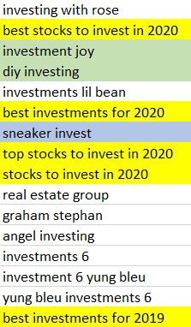
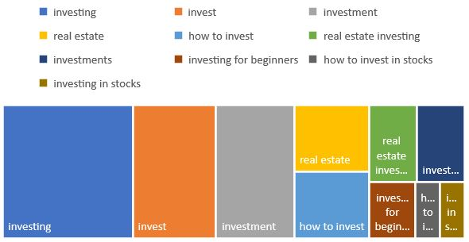
Social Media Analytics - YouTube
Period of data - (past year)
Top rising trends related to ‘investment’:
Top search queries related to the topic ‘investment’:

Slide 9
Top articles based on “Investment” keyword in Twitter & Reddit
Title | Total Engagement
The Faustian Bargain | Guggenheim Investments | 4540
How the 0.001% invest | 2154
The Laws of Investing | 1417
Pynk – Social Investing | 1342
GeorgeU – Learn how to invest | 1332
Investment Frequency Calculator | 1242
Treasurer's plea to business: Invest | 1084
The Merits of Bottoms Up Investing | 1021
The Social Subsidy of Angel Investing | 971
Webcasts: Investment Philosophies | 776

Slide 10
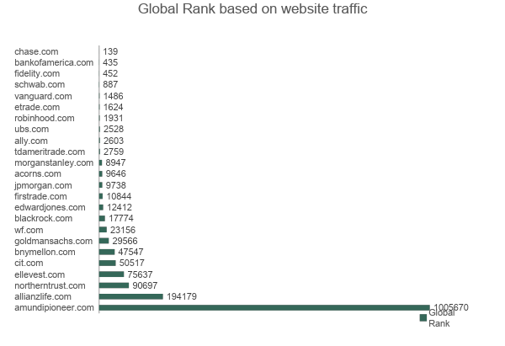
Competitor analysis
24
Investment companies’ websites were analyzed based on website traffic. Out of which,
9
Competitors were narrowed down based on the products/services offered and website traffic.
Vanguard, Etrade, Morgan, Stanley, Acorn, Blackrock, Robinhood, Ellevest, Schwab, Ameritrade.

Slide 11
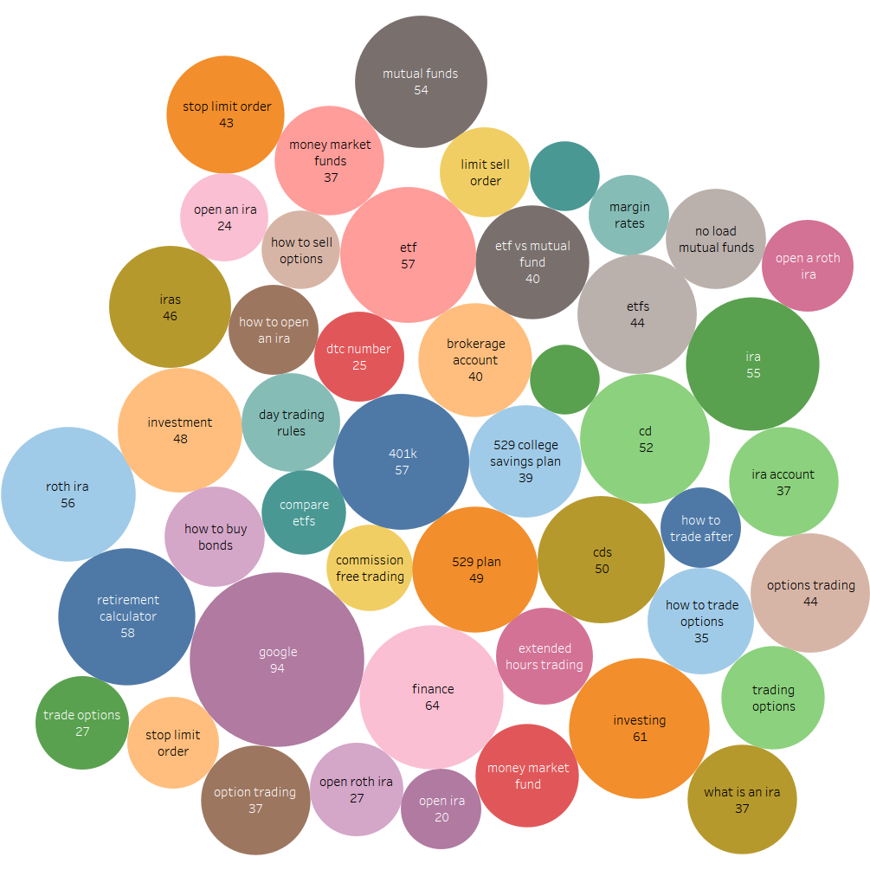
Popular keyword matrix
Popular keywords that the competitors get traffic for. The score represents how frequently users search for these keywords, on a scale of 0 to 100. Higher numbers & size indicate higher popularity.

Slide 12
Competitor website analysis
Standout features:
Morgan Stanley, Etrade, Schwab - Different primary color theme - Blue/Cyan
Ellevest - Rudimentary FAQ repository
All websites - Tools & Calculators
Ameritrade, Schwab – Live stock prices tracker

Slide 13
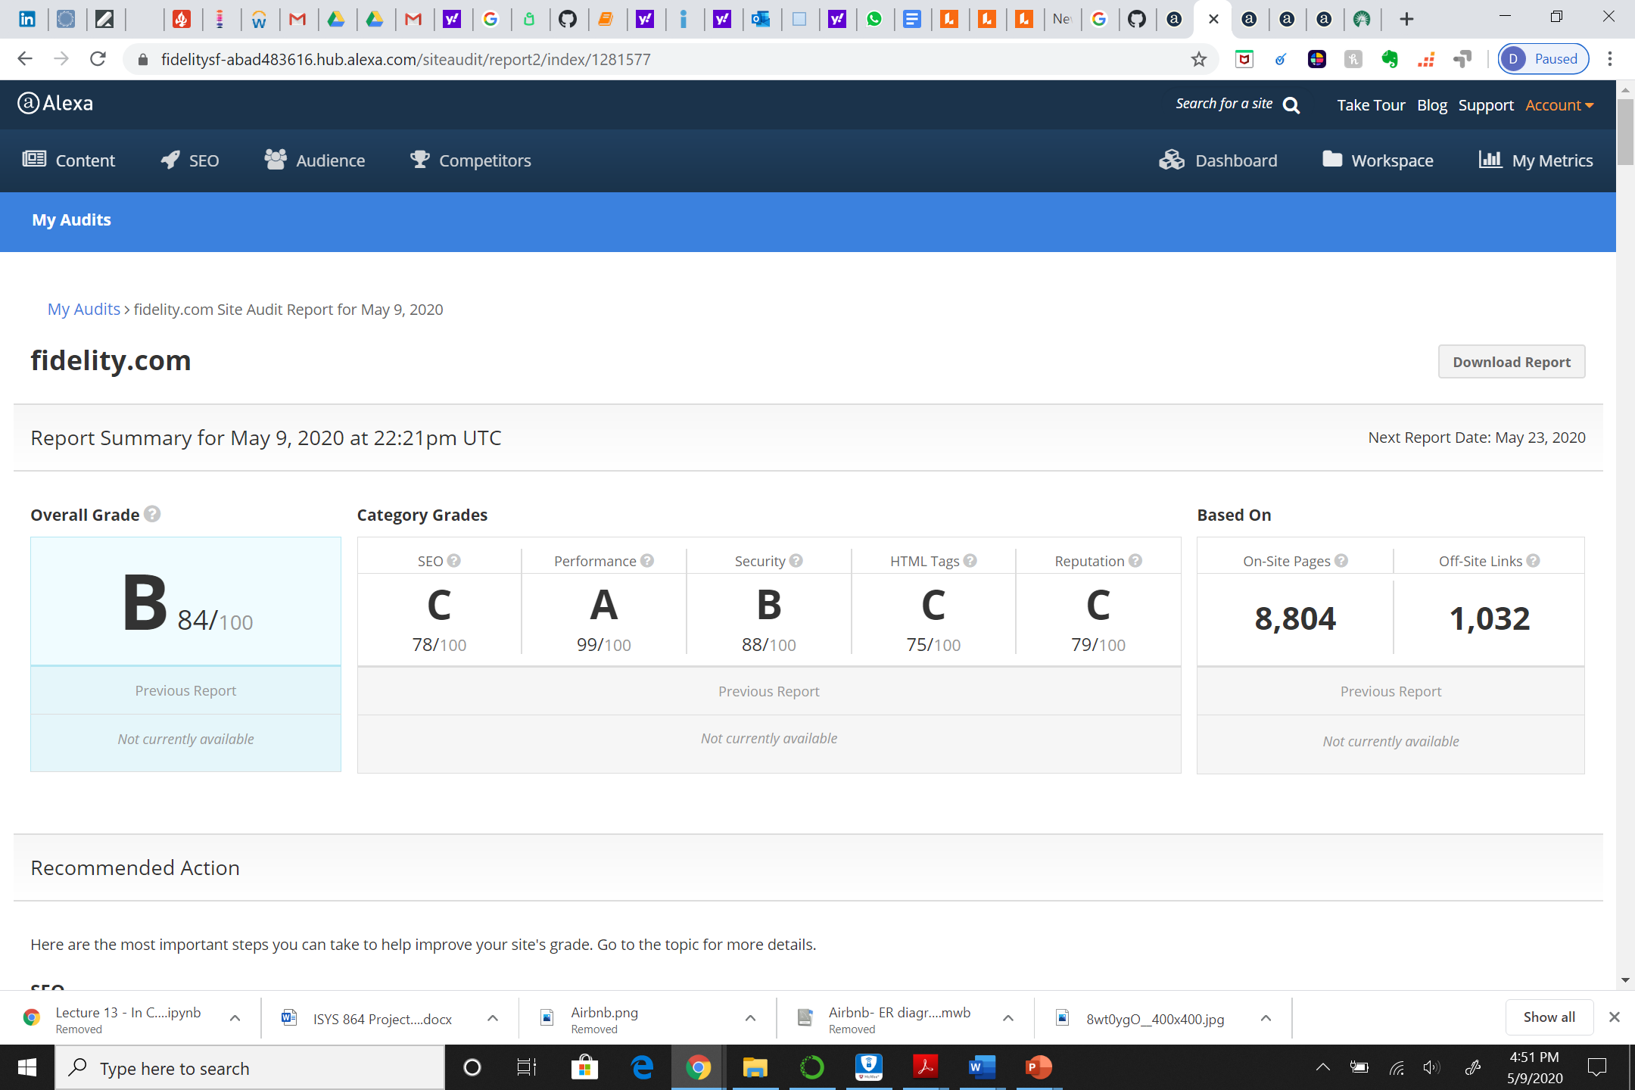
Fidelity website audit : Summary
Overall grade

Slide 14
Fidelity Website Audit : Recommendations
01
Duplicate title tags
Unique tags : 2697 pages | Duplicate tage : 6,109 pages
02
Reachability
Reachability
Easy to find : 3724 pages | Hard to find : 5082 pages
03
Long URLs
Long URLs
Good URLs : 7,461 pages | Long URLs : 1,345 pages
04
Many links
Many links
Acceptable links: 7,835 pages | Long URLs : 971 pages

Slide 15
Recommended actions
Reduce number of links on designated pages
Fix broken links
Give each page a unique meta description
Add links to dead end pages
Add on-site links to important pages
Improve error page
Replace generic anchor text
Fix server errors
Add links to hard-to-find pages
Remove insecure meta tags

Slide 16




Summary of the research results
SOCIAL MEDIA ANALYTICS
Identified the top articles, videos, top trends from Youtube, Reddit and Twitter
SEARCH ENGINE ANALYTICS
Identified top trends, search queries related to Investment
COMPETITOR ANALYTICS
Identified the top keywords and products that are engaged the most in the competitor websites
FIDELITY WEBSITE AUDIT
Identified areas to improve in terms of site SEO, performance, HTML tags

Slide 17
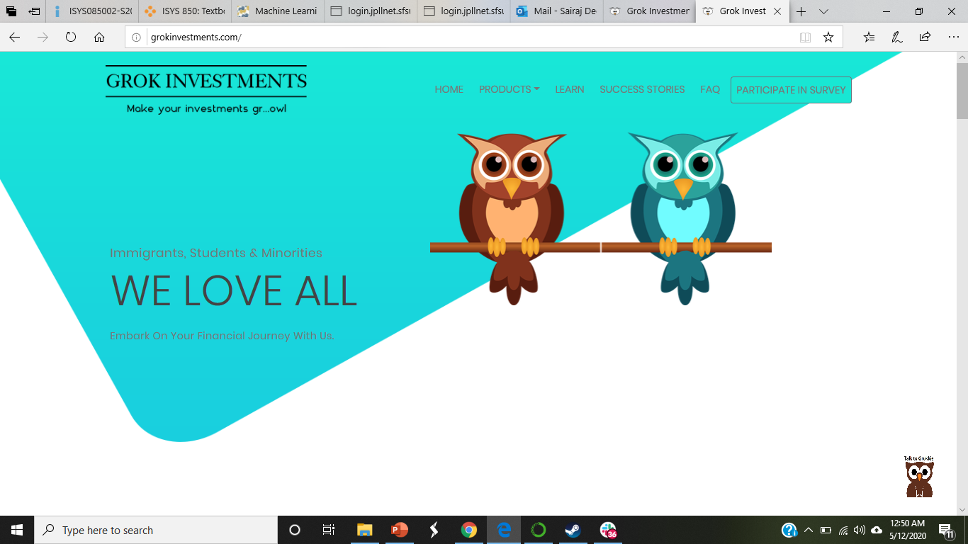
Grok Investments
With the goal of identifying important features for millenial’s interactivity, we incorporated the following features like:
Chatbot
Quiz
Learn

Slide 18
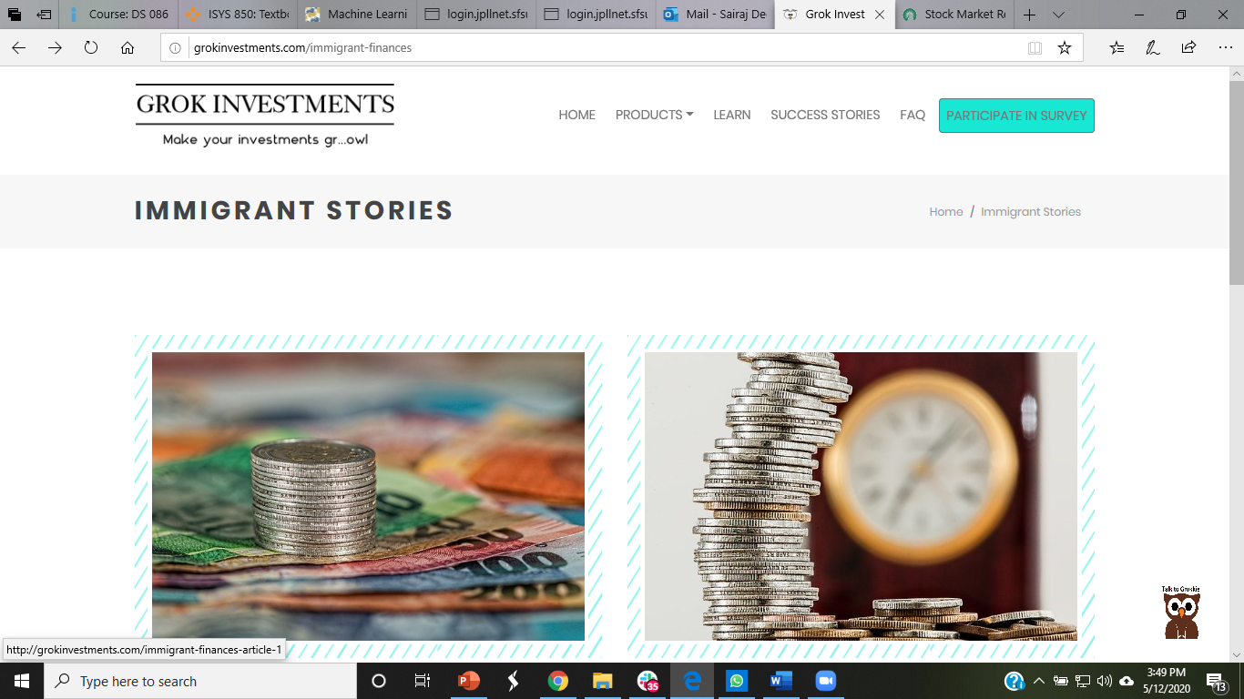
Success Stories

Slide 19
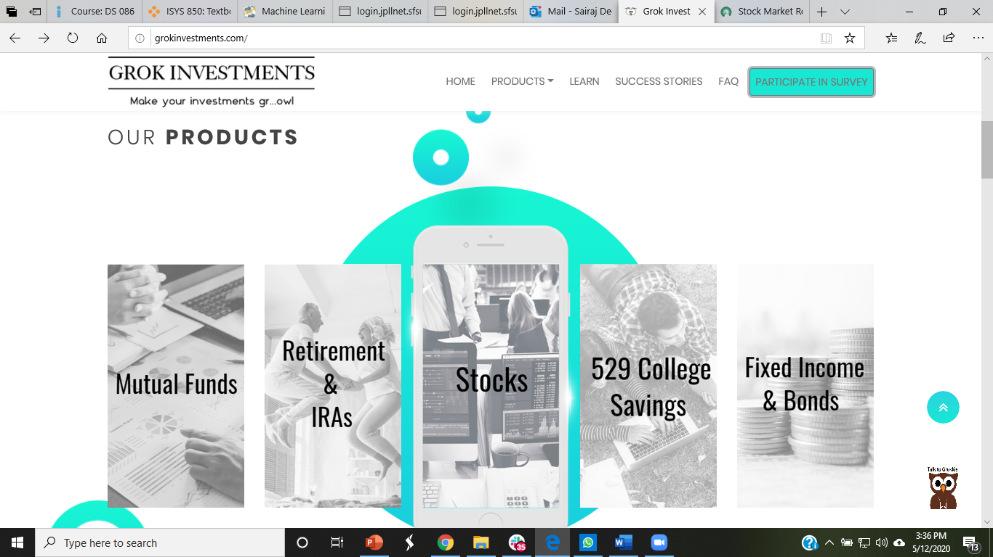
Products

Slide 20
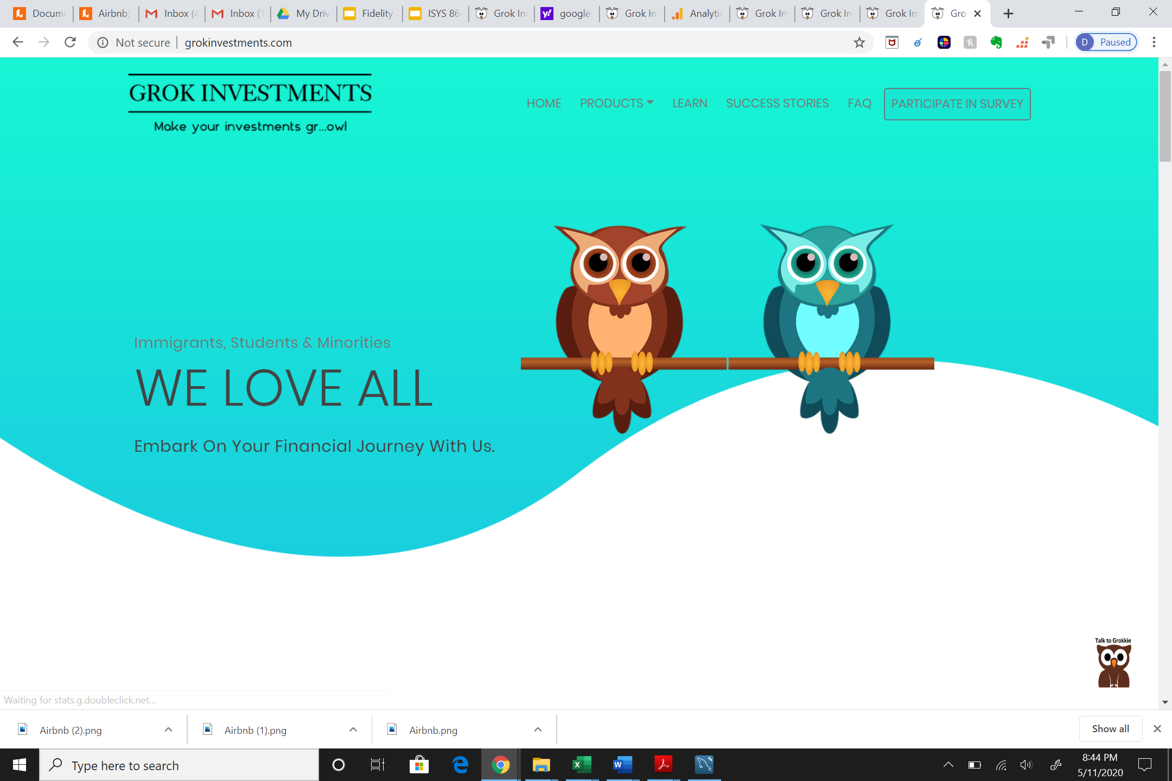

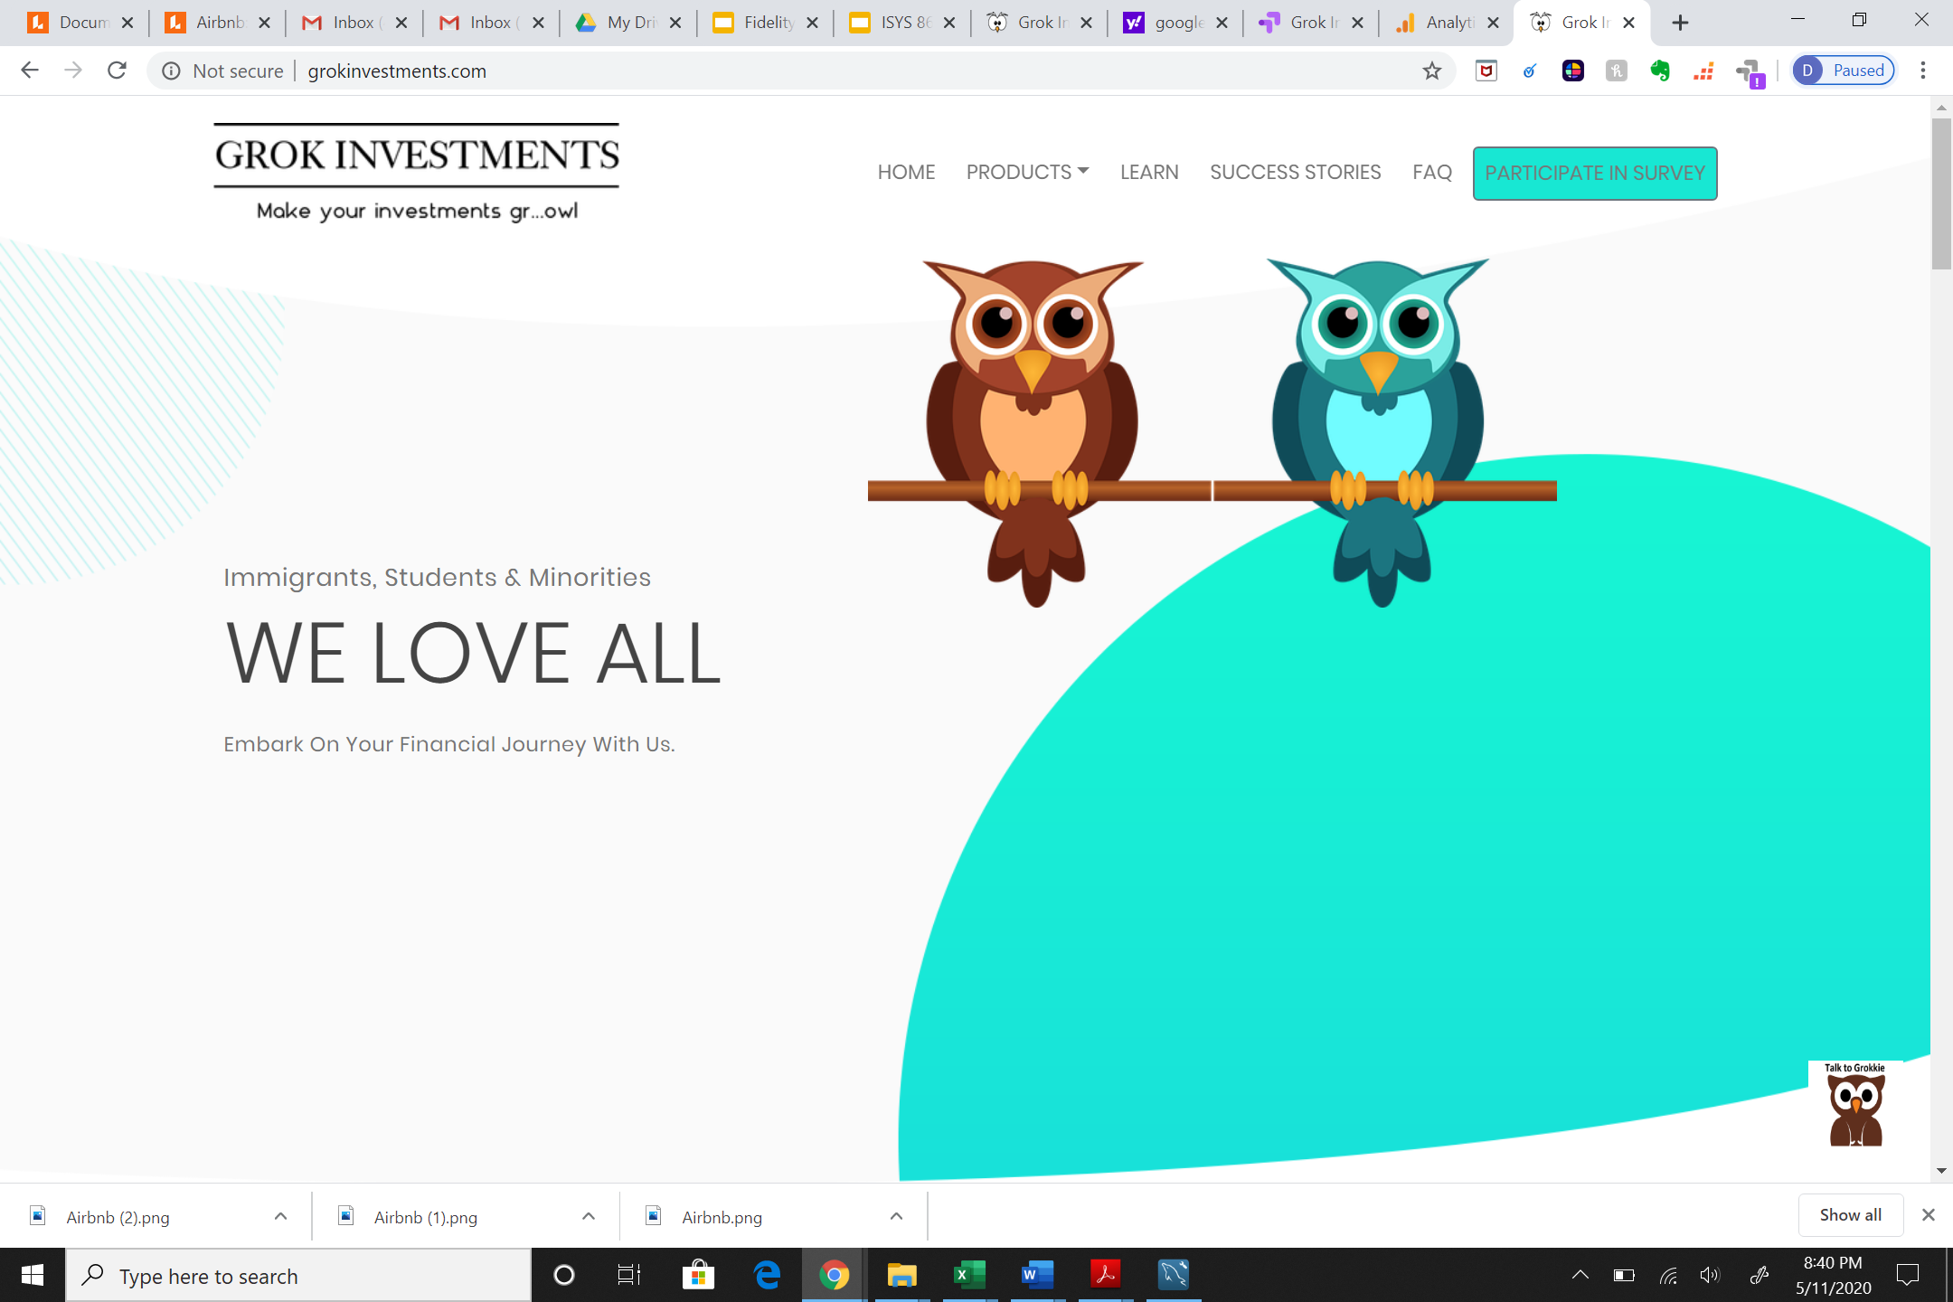
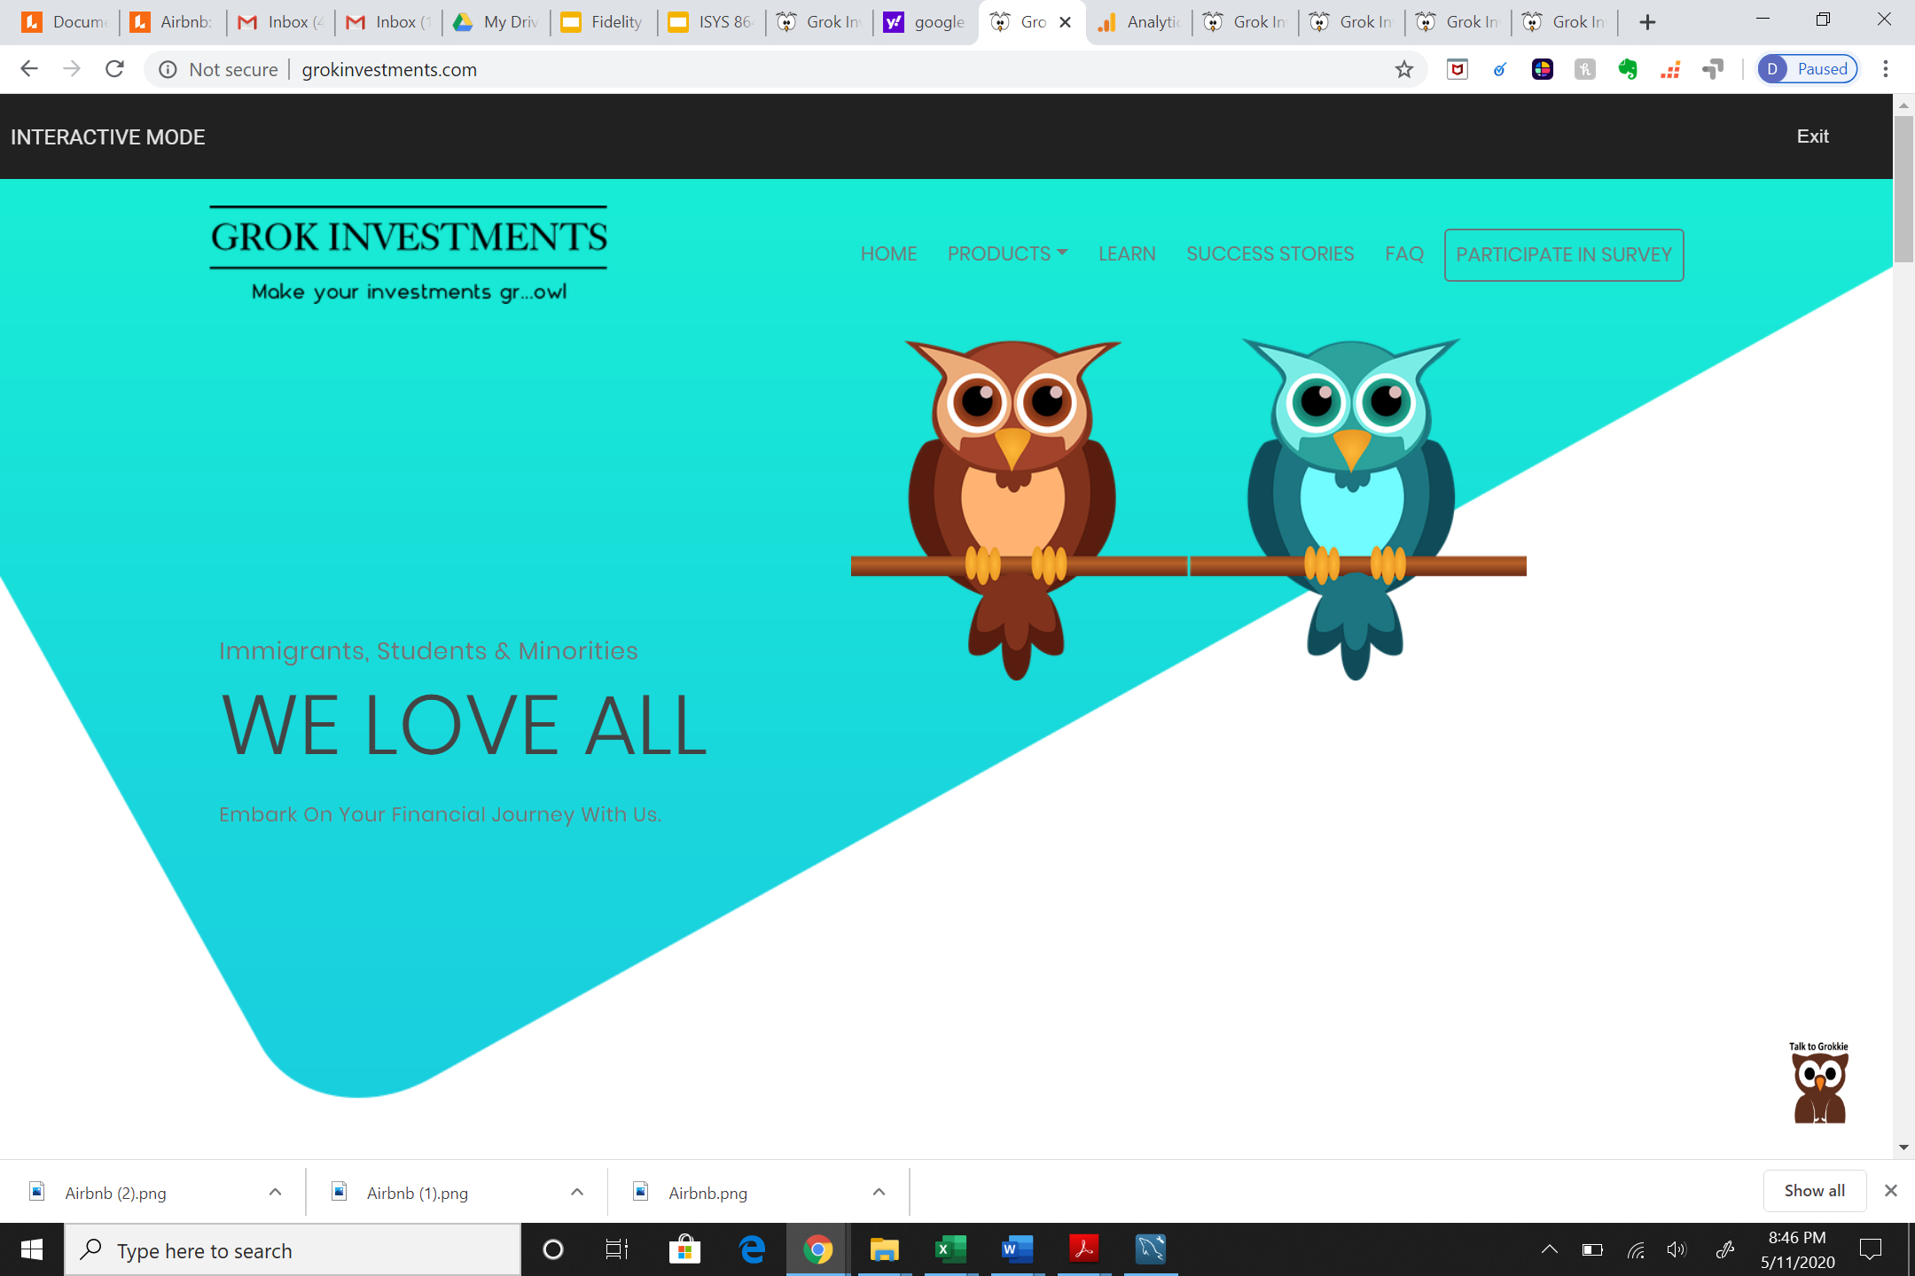

Website Features: Multiple Landing Pages
ORIGINAL
VARIANT 1
VARIANT 2

Slide 21
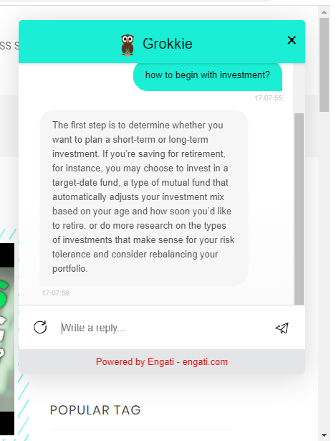
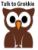
Website Features: Grokkie (Chatbot)
◼ Grokkie is fed with FAQ’s, which helps to quickly access general user questions.

Slide 22
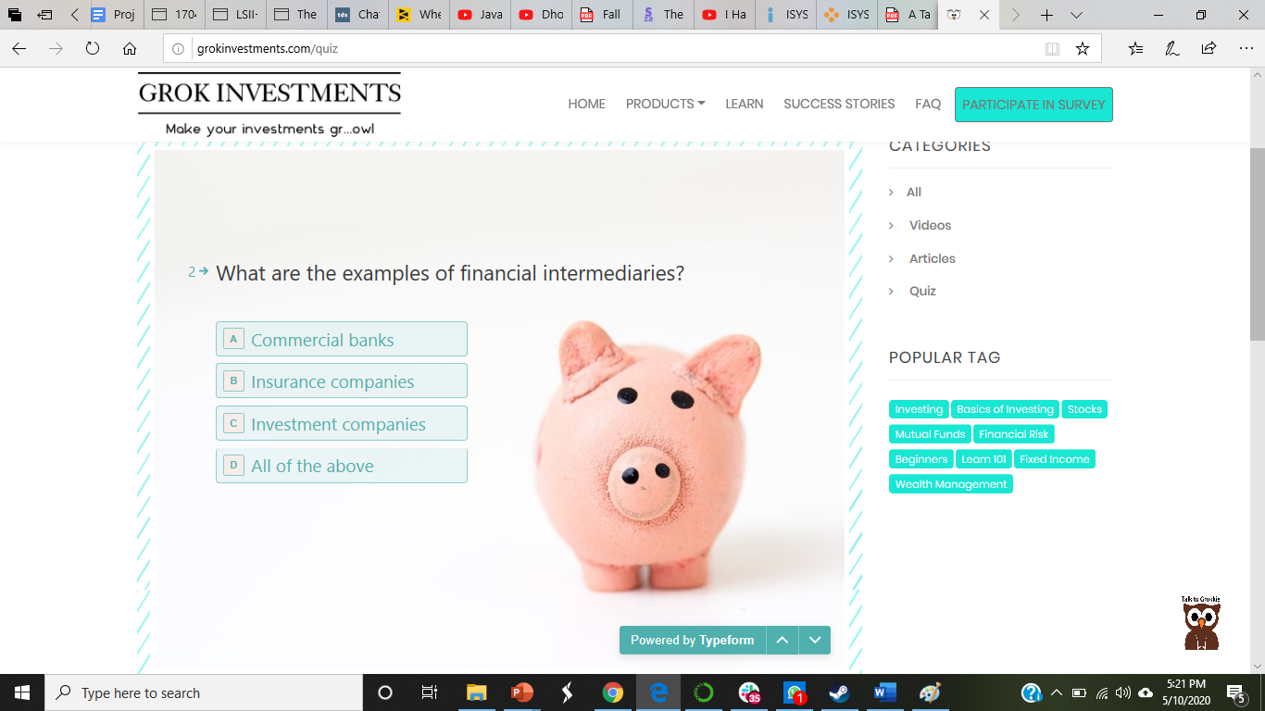
Website Features: Quiz
◼ Increasing user interactivity.
◼ Consists of finance related questions, with difficulty levels easy & moderate.
◼ Gaining insights about user’s understandings of investments.

Slide 23
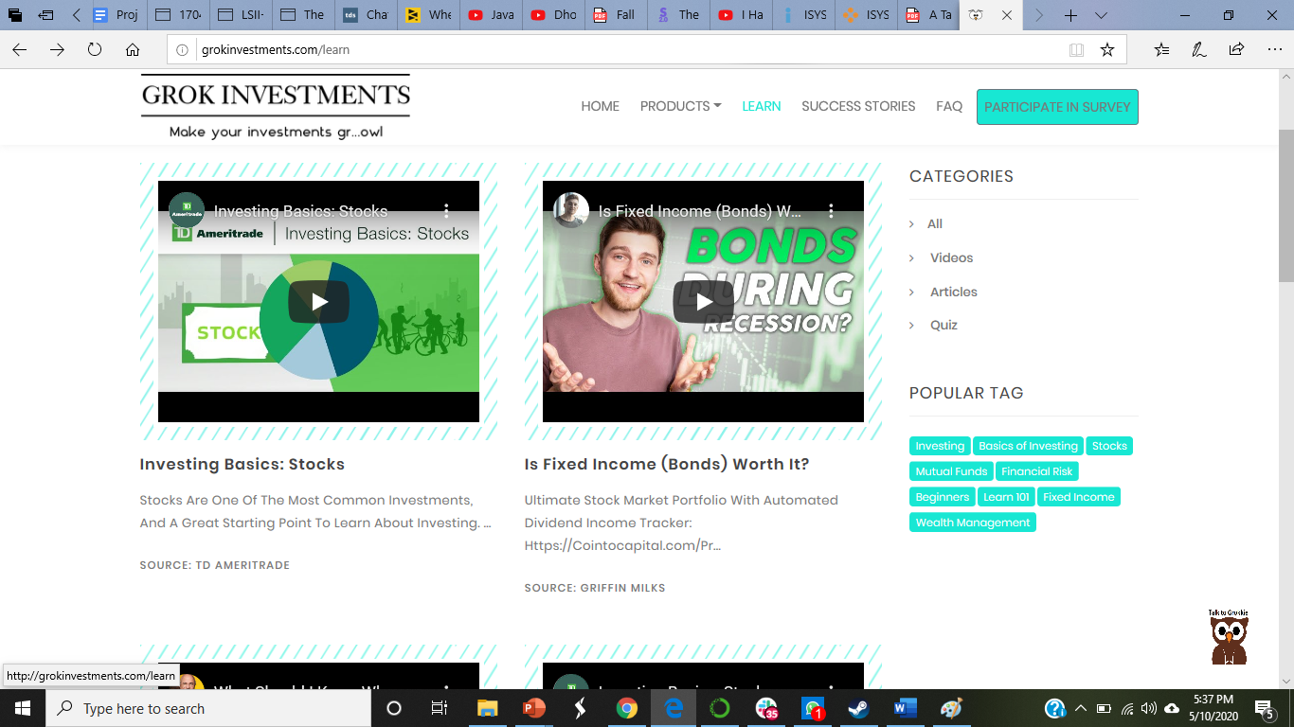
Website Features: Learn
◼ Content Navigation
◼ Recommending top videos based on social media analysis.
◼ Encouraging our users to have fun learning to investing.

Slide 24
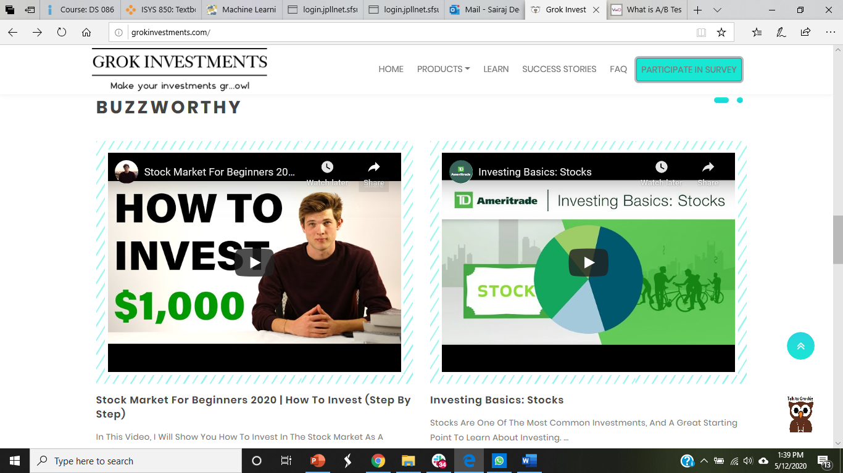
Website Feature: Featured Content (Buzzworthy)

Slide 25
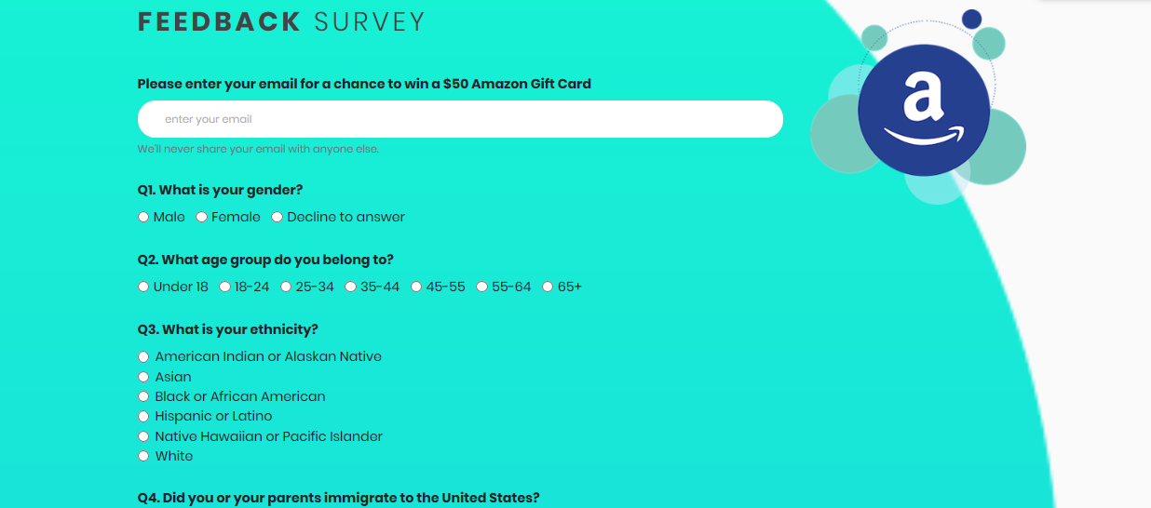
Website Features: User Survey

Slide 26
Wish List and Analysis

Slide 27
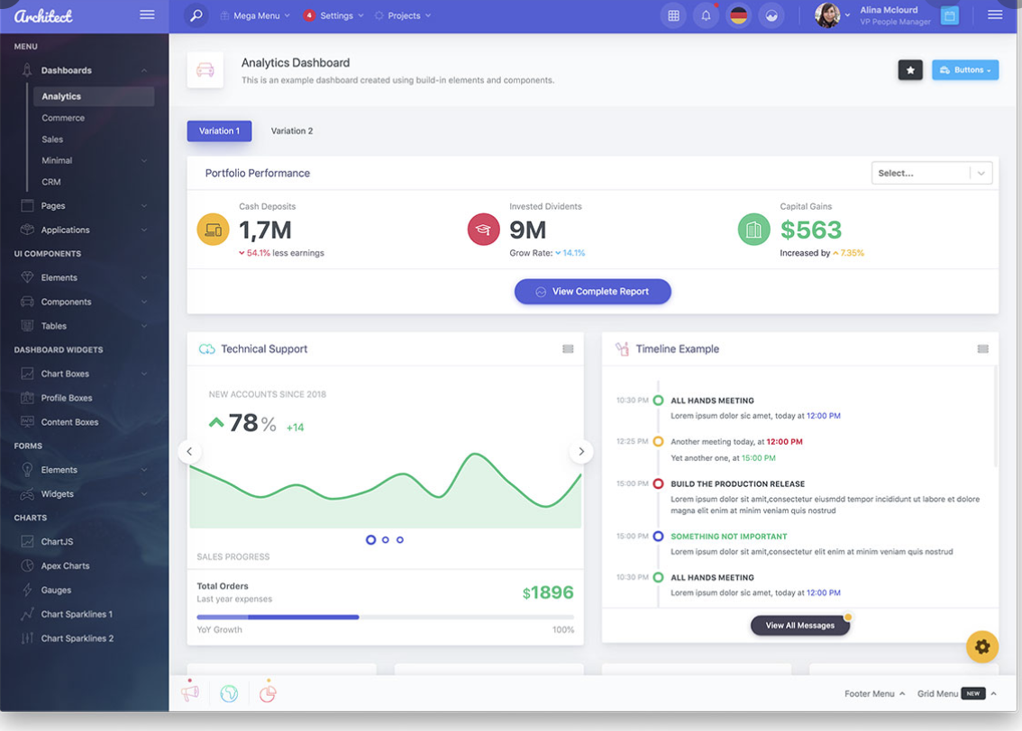



Product Wish List
Personalized Dashboard
Interactivity
Recommended Content
Advanced Chatbot

Slide 28
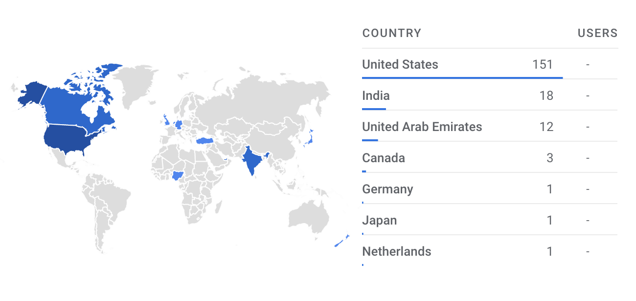
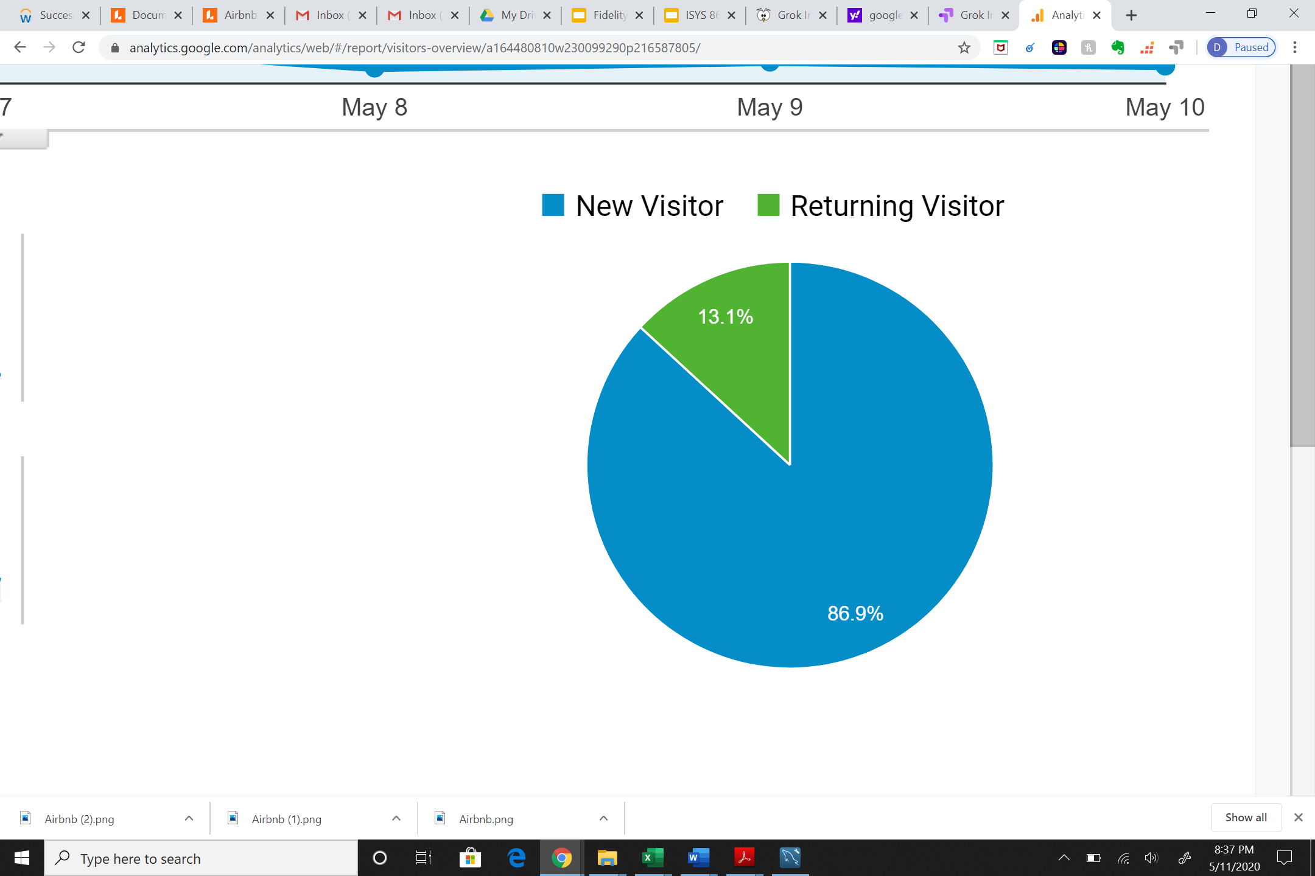
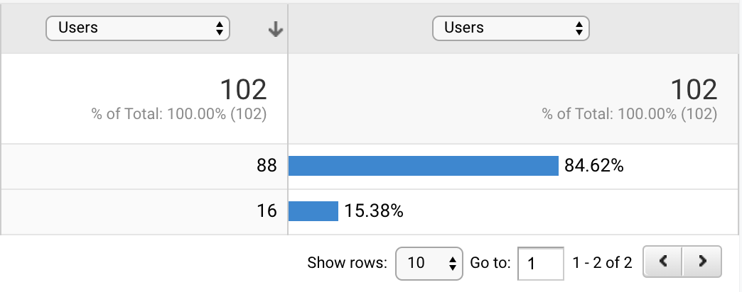
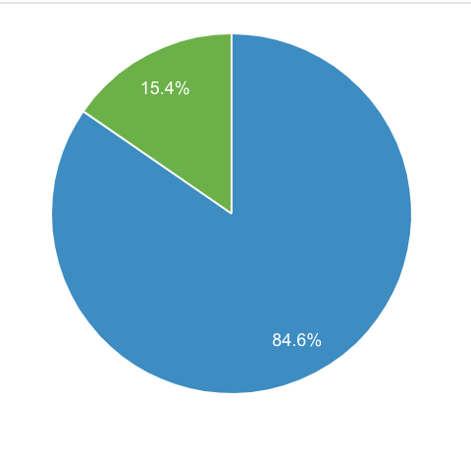
Website Analytics: Average Daily Users

Slide 29
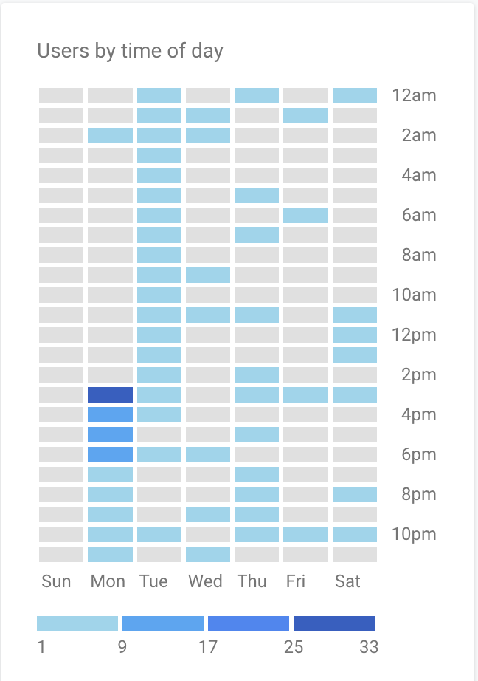
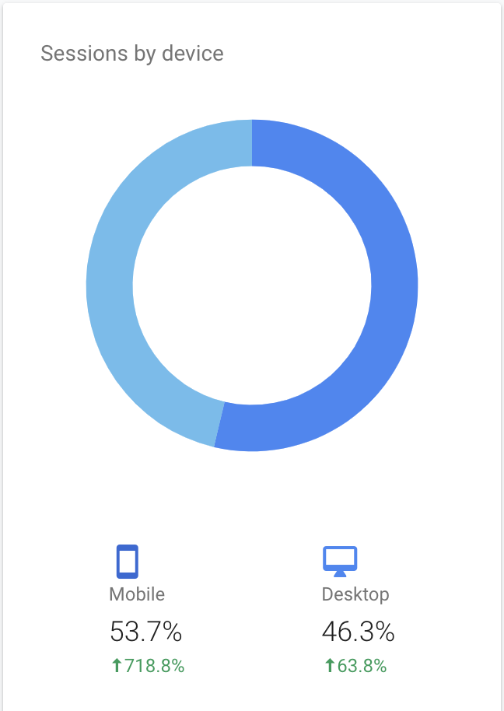
Website Analytics: User Visits

Slide 30
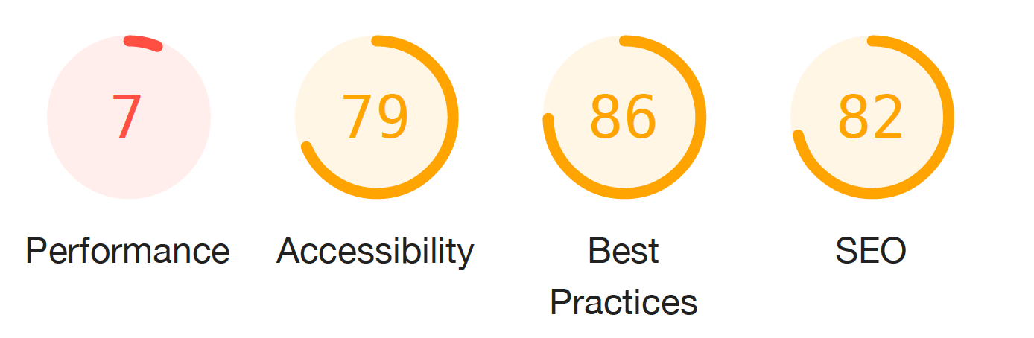
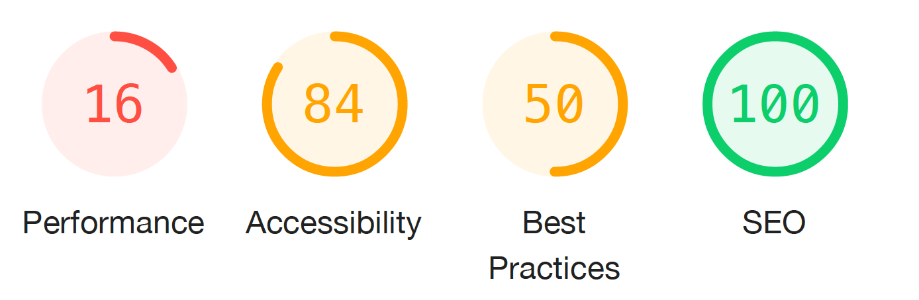
Analysis: Website Performance (Mobile/Desktop)
Google Chrome Lighthouse Audit Report
Fidelity Investments
Grok Investments

Slide 31
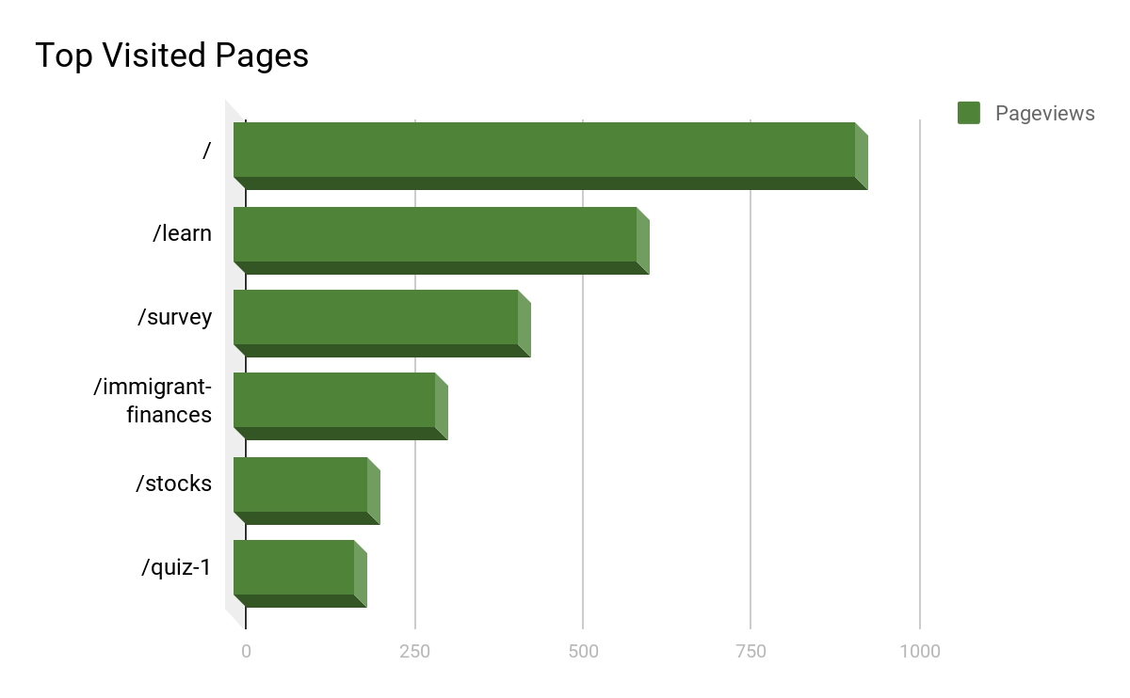
Website Analytics: Top Visited Pages

Slide 32
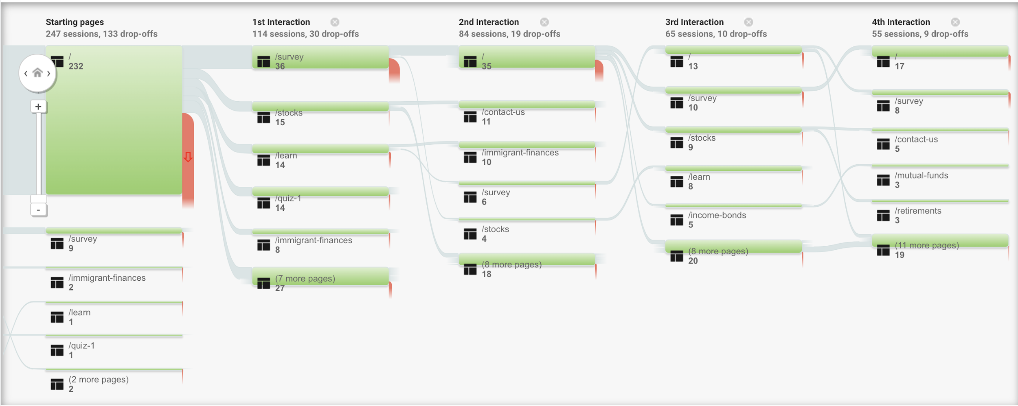
Website Analytics: User Activity Flow

Slide 33
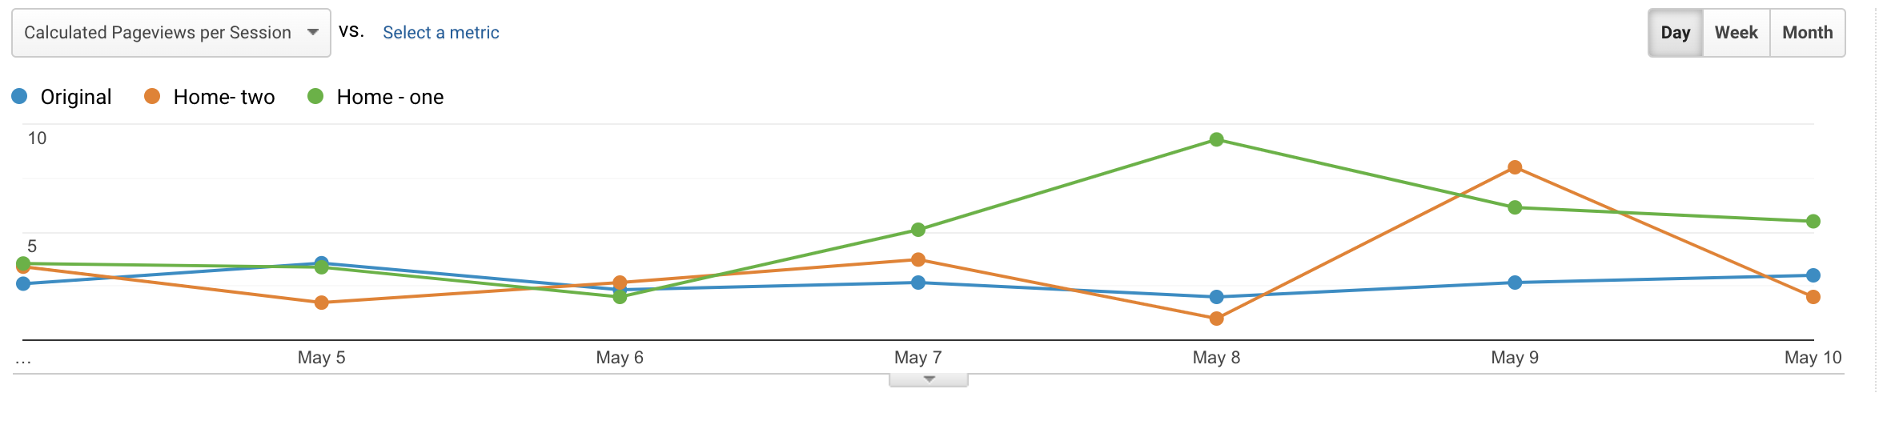
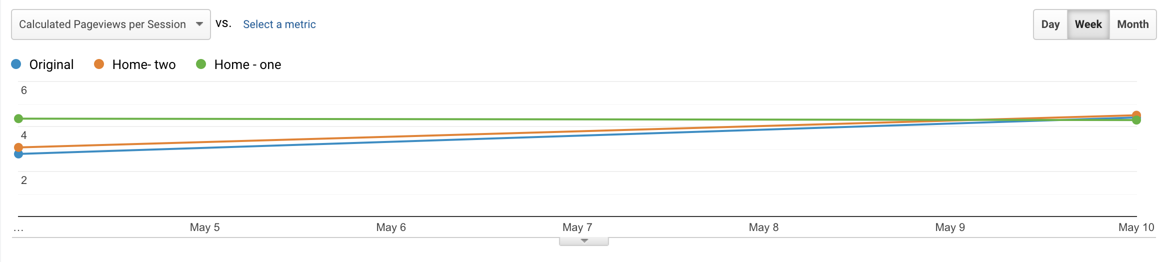
Analysis: Landing Page (A/B/n) Testing
Pageviews per Session

Slide 34
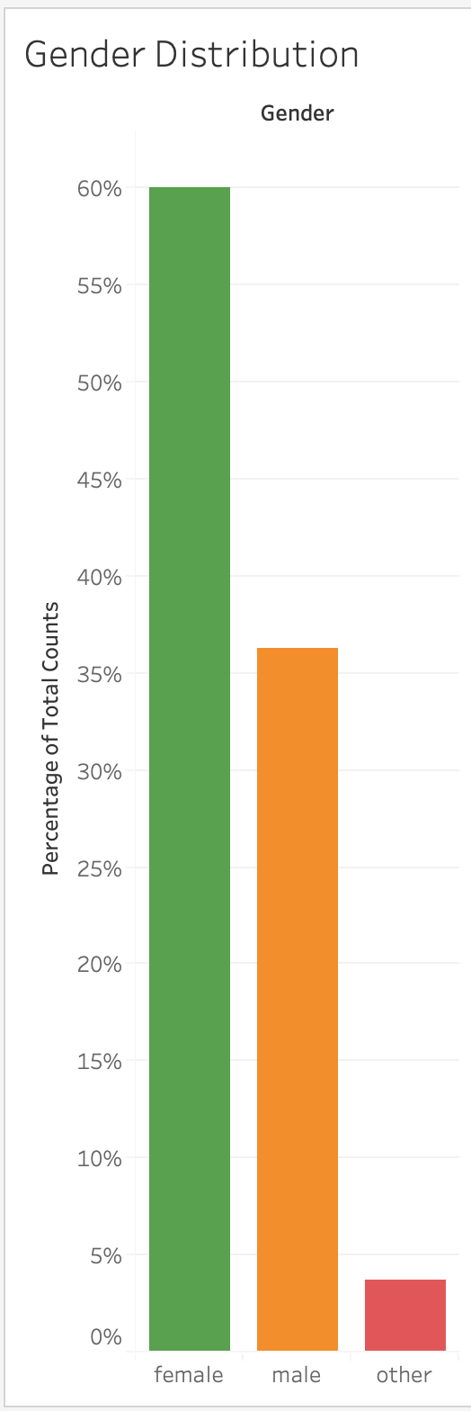
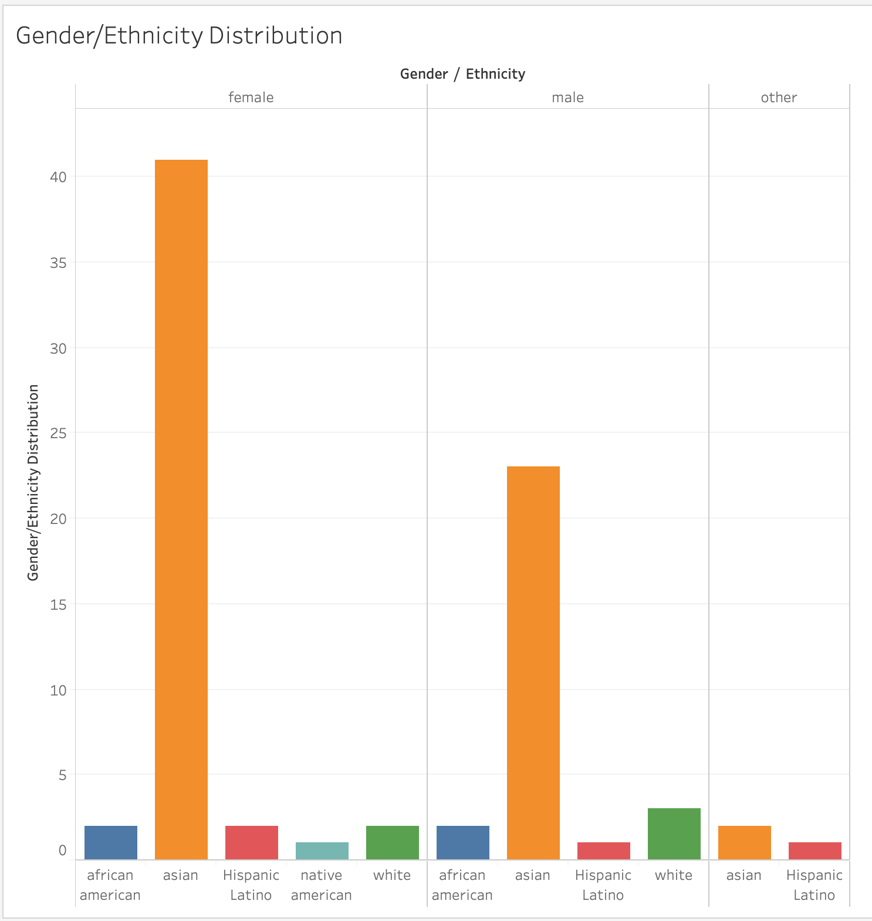
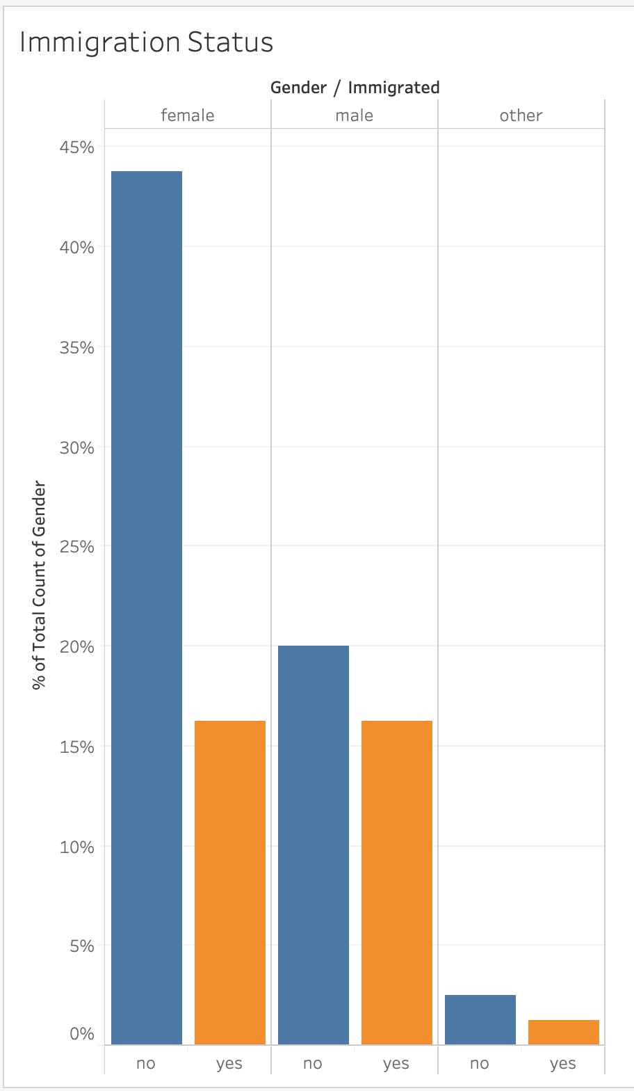
Survey Analysis: User Statistics

Slide 35
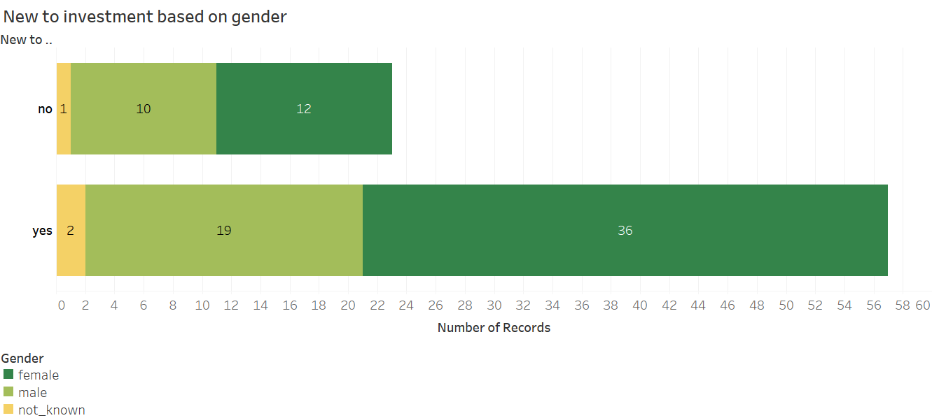
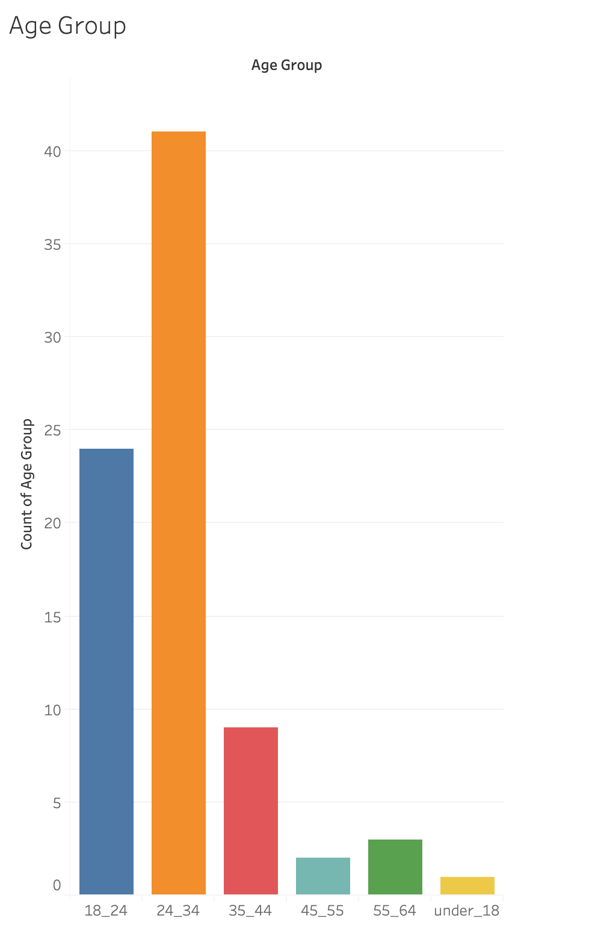
Survey Analysis: Investment Experience

Slide 36
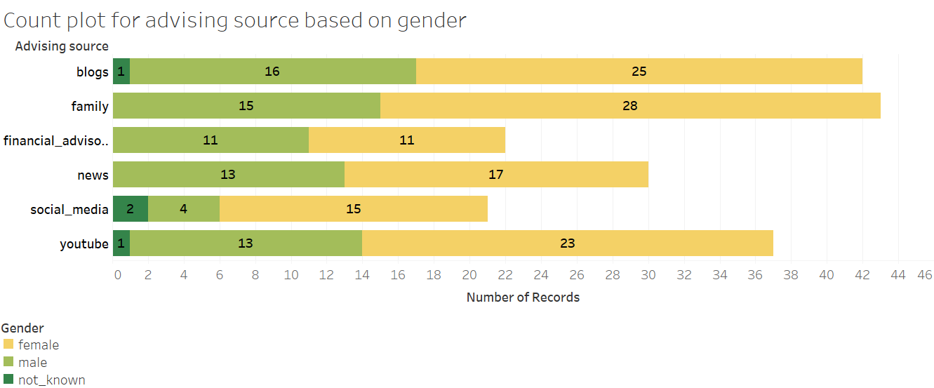
Analysis: Advising Sources

Slide 37
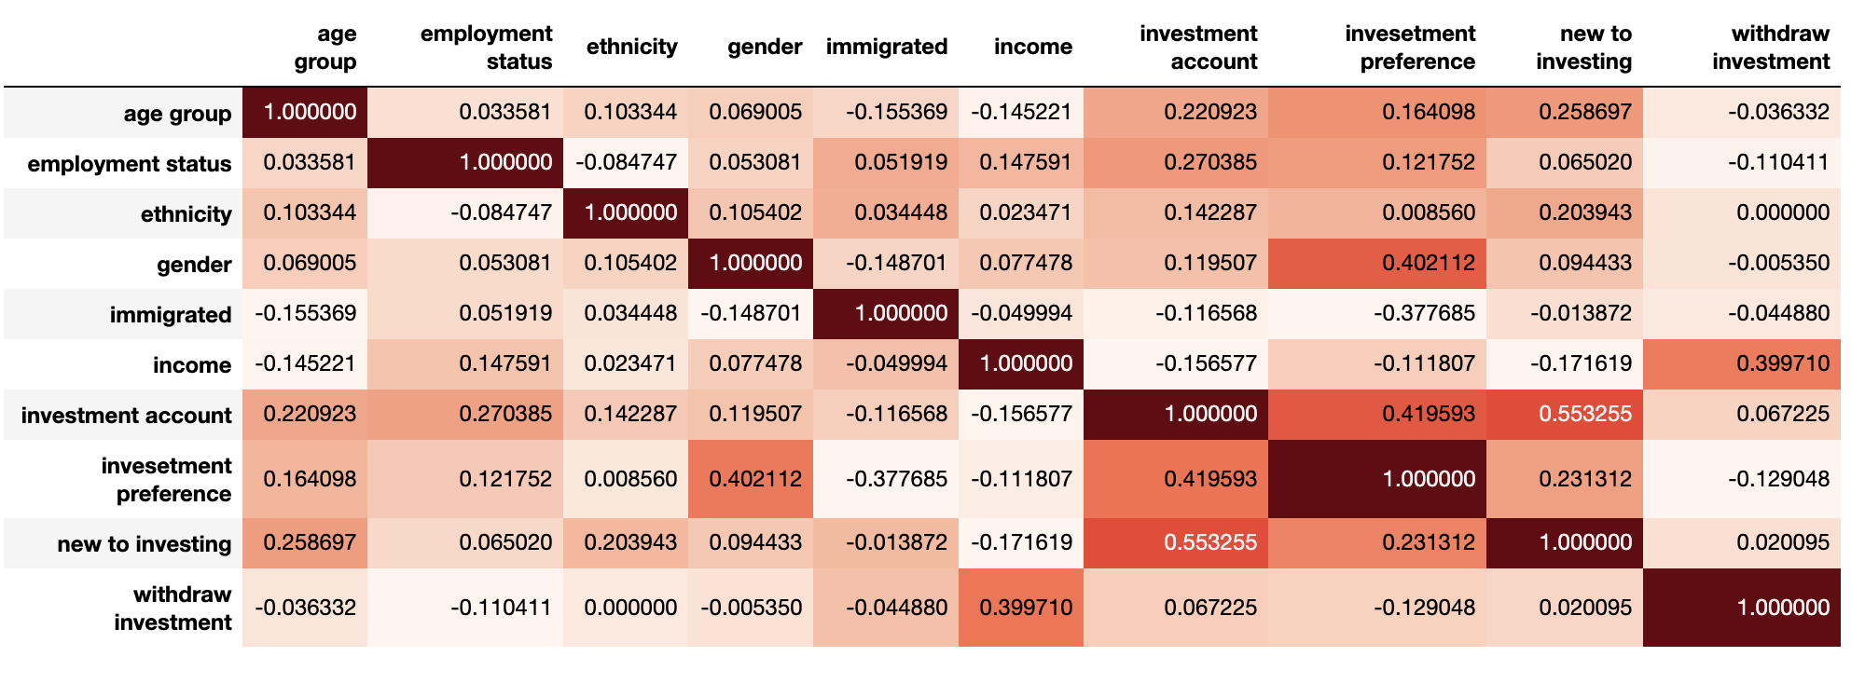
Analysis: Finding Correlations

Slide 38
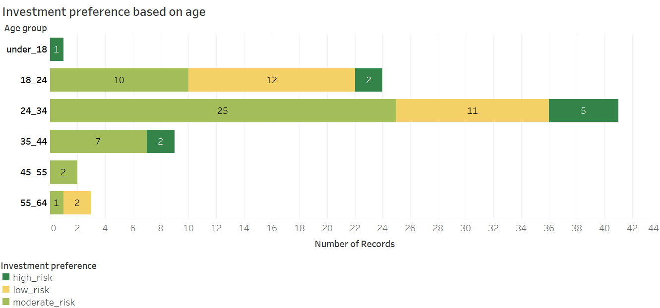
Analysis: Age vs Investment Preference

Slide 39
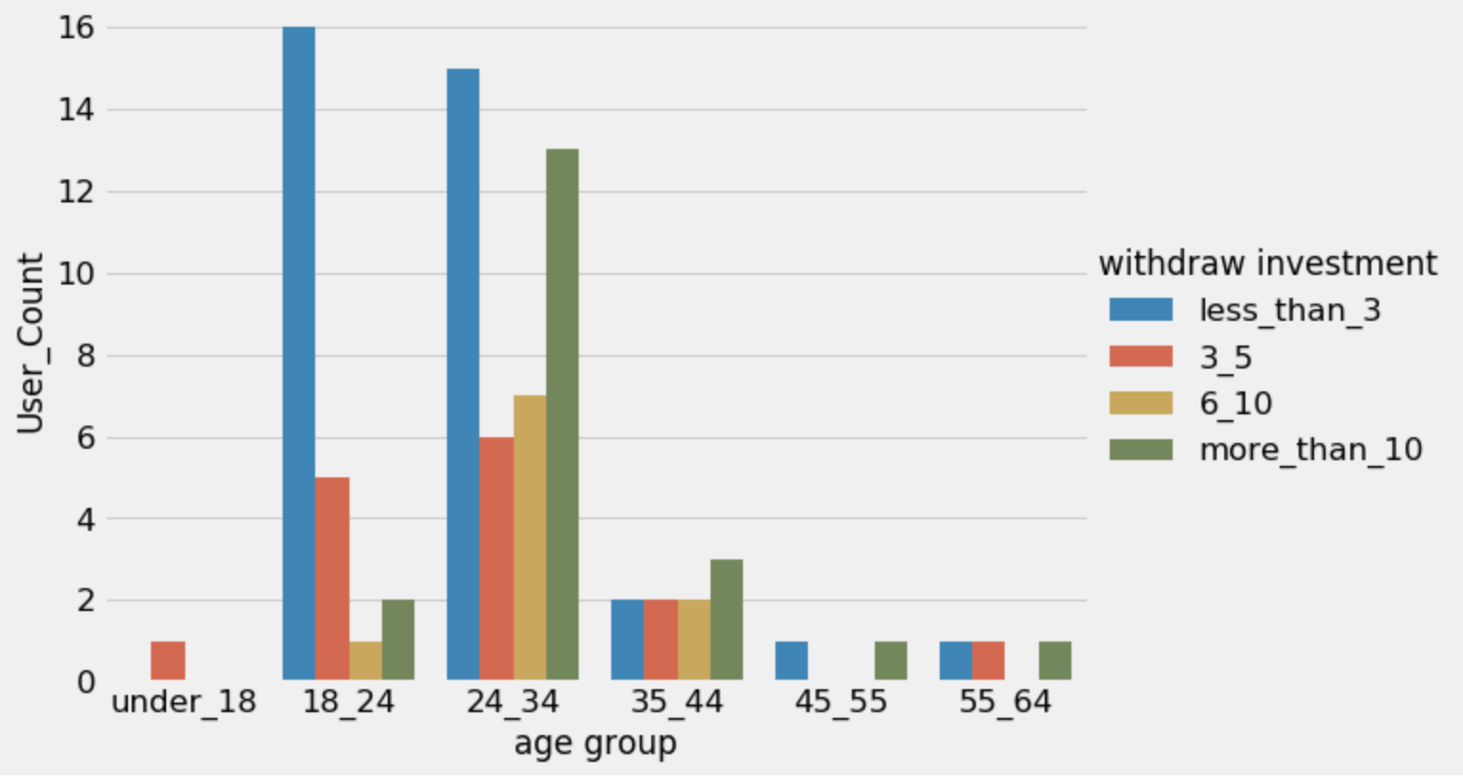
Analysis: Age group vs Investment Period

Slide 40
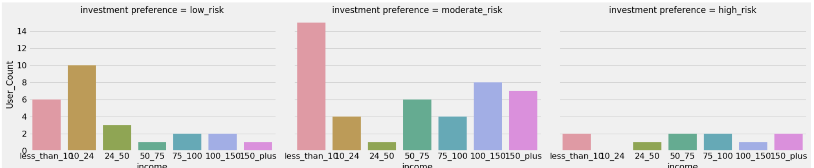
Analysis: Income vs Investment Preference

Slide 41
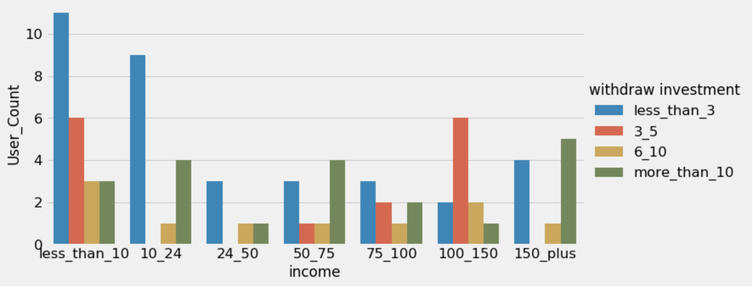
Analysis: Income vs Investment Period

Slide 42
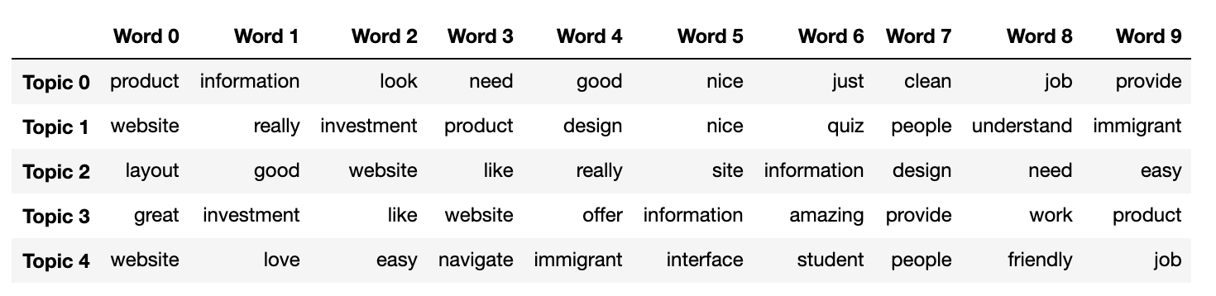
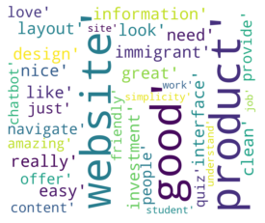
Analysis: User Comments (Topic Modeling)

Slide 43
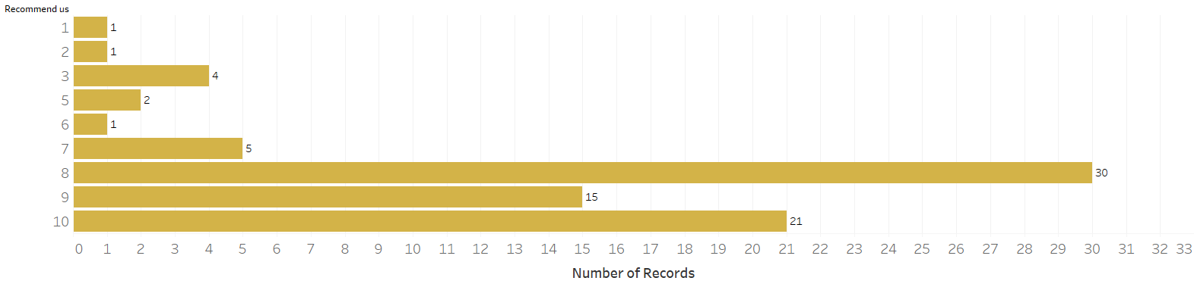
Analysis: Our Ratings

Slide 44
Results
60 % were female, 45% were non-immigrant, 80% were Asians in the SF Bay Area and 80% were 35 years old and less.
55% were new to investing, and the percentage of the female respondents new to investing was almost double as compared to men.
Advising sources - 63% preferred was YouTube, online blogs, and family as compared to professional financial advice.
Positive correlation between investment account ownership and investment experience. Most of the people who were new to investment did not own an investment account.

Slide 45
Results
Majority of the users preferred low to moderate risk, and the majority of them favored short term investments.
Positive correlation between low income and low risk. However, there was no direct correlation between income and investment period.
Feedback comments - website layout, clean design, quiz, and products
Our average rating was 9/10.

Slide 46
Recommendations
Website recommendations:
The Fidelity’s “Learning Center” should be transformed into a prominent feature on the Fidelity homepage, to engage visitors for longer durations.
Add products keeping in mind the requirements of immigrants on work visas.
Fidelity should explore starting a podcast to be uploaded on YouTube, embedded in the blogs/news & research/insights part of their website to attract more visitors to the website.
Website performance in terms of accessibility and SEO needs to be improved.

Slide 47


